Slide 1
Preparing For And Keeping Food Safe During A
Power Outage

Slide 2
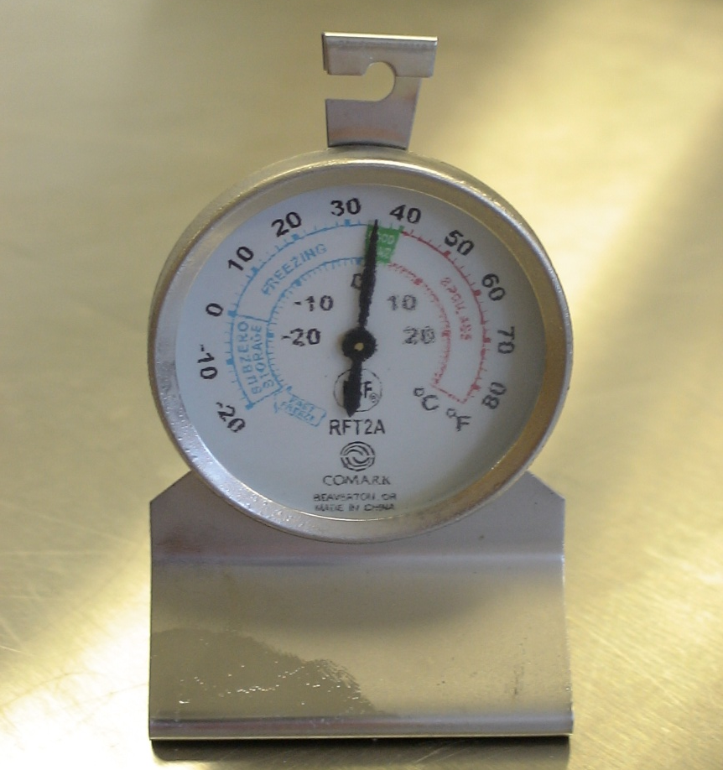
Preparing for a Possible
Power Outage
Keep a thermometer in your refrigerator and freezer

Slide 3
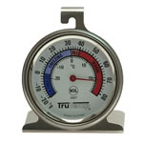
Preparing for a Possible
Power Outage
Freeze Water
  Wash the container thoroughly before using
  Use to keep food cold if the power goes out
  Use for drinking as it thaws
4. Long-handled Bottle Brush
  You will use this tool for cleaning jars and bottles. It also works well if you're trying to clean around the inside edges of pots and pans.
5. Dish Cloths
  Use a clean dish cloth everyday to wash dishes, wipe up spills and clean the kitchen counter.
  Wash the dishcloth, after each meal, in the washing machine on hot water cycle and dry in a hot dryer (NO MORE C-LES).
  Dishcloths are easier to keep clean than sponges and can be purchased inexpensively.
6. Mop
  For your safety, wet spills should be cleaned up immediately. After sweeping, mop kitchen floors for cleanliness and to prevent the growth of CLES.
7. Paper Towels
  You can use paper towels to clean the kitchen or maybe use a combination of paper towels and dishcloths.
    It might be easier to wipe up small spills and clean small areas with a paper towel.
    Use a dishcloth for cleaning larger areas.
  After each use just throw the paper towel away.
8. Refrigerator/Freezer/Appliance Thermometer
  Use a thermometer so you know the inside temperature of your refrigerator and freezer.
    The refrigerator temperature control dial does not give the temperature.
4. Long-handled Bottle Brush
  You will use this tool for cleaning jars and bottles. It also works well if you're trying to clean around the inside edges of pots and pans.
5. Dish Cloths
  Use a clean dish cloth everyday to wash dishes, wipe up spills and clean the kitchen counter.
  Wash the dishcloth, after each meal, in the washing machine on hot water cycle and dry in a hot dryer (NO MORE C-LES).
  Dishcloths are easier to keep clean than sponges and can be purchased inexpensively.
6. Mop
  For your safety, wet spills should be cleaned up immediately. After sweeping, mop kitchen floors for cleanliness and to prevent the growth of CLES.
7. Paper Towels
  You can use paper towels to clean the kitchen or maybe use a combination of paper towels and dishcloths.
    It might be easier to wipe up small spills and clean small areas with a paper towel.
    Use a dishcloth for cleaning larger areas.
  After each use just throw the paper towel away.
8. Refrigerator/Freezer/Appliance Thermometer
  Use a thermometer so you know the inside temperature of your refrigerator and freezer.
    The refrigerator temperature control dial does not give the temperature.
Page 3
Page 3

Slide 4
Preparing for a Possible
Power Outage
Purchase a generator
Have a cooler
  This will be used to store food and keep it cold
Freeze refrigerated items that are not going to be used immediately
  Meat
  Milk and leftovers

Slide 5
What to do during a Power Outage
Keep refrigerator and freezer doors closed
  This will keep the food cold
Keep foods close together in the freezer
  This will help the freezer keep its temperature longer
Place foods in a cooler with frozen ice or gel packs
  Do this only if the freezer is full

Slide 6
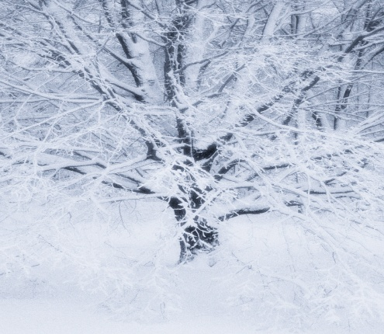
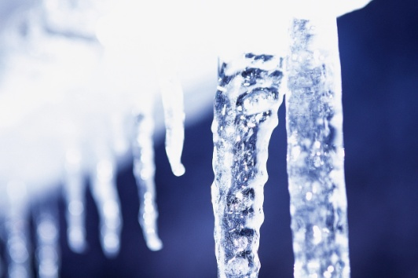
What to do during a Power Outage Cont.
Do not place food outside
  Temperatures can vary
  Animals might get the food
If it is cold outside:
  Fill empty containers with water and place outside to freeze
  Snow and ice can be used in a separate container
  Use the frozen containers in the refrigerator, freezer, or cooler

Slide 7
Preparing Food during a Power Outage
Heat foods outdoors
  Camp Stoves
  Grills
  Contained Fires
Build a fire
  Use the fireplace to heat food

Slide 8
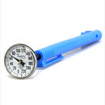
Handling Food After A Power Outage
Discard refrigerated perishable foods after 4 hours without power
  Milk and other dairy products
  Meat
Check the foods temperatures.
  If the temperature is below 40˚F, the food should be safe to eat.
Check for ice crystals on foods in the freezer.
  Food can be refrozen or cooked.
Food Thermometer

Slide 9

Handling Food After A Power Outage
Throw out any foods that have
  Unusual texture
  Color
  Odor
NEVER TASTE food to see if it is safe.

Slide 10
When In Doubt, Throw The
Food Out!
Wasting a few dollars now may save you discomfort, doctor bills or even a hospital stay later.

Slide 11
Conclusion
Keep an appliance thermometer in both your refrigerator and freezer.
Keep the refrigerator and freezer doors closed during a power outage.
Use a cooler if the temperature rises above 40˚ F in the refrigerator or freezer.

Slide 12
Conclusion
Never use camps stoves or grills indoors to cook food.
Discard all foods that have an unusual texture, color, or odor.

